Slide 1
CAH Swing Bed PI/QI
Benchmarking Project
Staff Training Slides
January 10, 2020
Mary Guyot Consulting
207-650-5830 (cell/text)
maryguyotconsulting@gmail.com

Slide 2
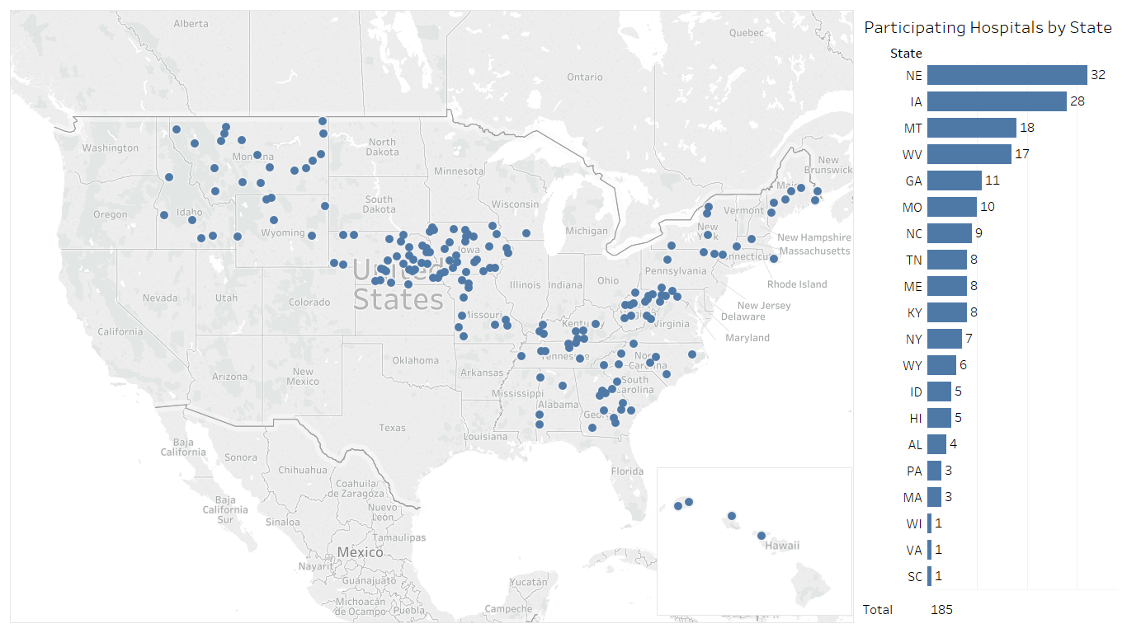
Participating Hospitals as of July 2019
Now up to 209 hospitals in 21 State – Stroudwater’s goal is 300 by the end of the year
Source: Stroudwater Swing Bed Portal 4/1/2018 to 7/8/2019

Slide 3
CAH SB Benchmarking Project (2019-2020) – No longer a Pilot
Pilot project has ended – Ira Moscovice’s report will be discussed at the Jan 29th meeting (Outcome of the project) – Data is no longer going to University of Minnesota
Stroudwater continues providing the data inputting and reporting portal
Mary Guyot Consulting continues to support the project as a SB/SNF expert
CEOs must have signed a Subscription Agreement with Stroudwater Associates in order for hospitals to access the data portal
Hospitals must identify 2-3 people (referred to as end-users ) who are or will be trained by Stroudwater to enter data in their tool and pull reports for the hospital SB PI/QI. (old and new hospitals)
End-users must have registered with Stroudwater (special form to complete) to have access to the website for the data portal)
WV and AL contracts with Mary Guyot Consulting to provide the hospitals clinical training, facilitate meetings, analyze and present the benchmarked data as well as discuss best practice and provide SB program education regarding utilization and quality
Those using the portal will be notified of webinars from Stroudwater where anybody from your hospital can call in. Depending on the topic you may or may not participate since we cover the material in quarterly meetings ourselves when lessons learned are shared with you all.

Slide 4
CAH SB Benchmarking Project (2019-2020)
If you are a new CAH or newly participating CAH, you must participate in an IRR process with an open-book test before you start – I will work with you on this.
WV has quarterly meetings ideally attended by the SB Coordinator, therapy, hospital PI/QI Dir., nursing rep and end-users (most often the same as one of the above positions)
The October 2019 benchmarking kick-off was a webinar
Meetings for 2020 are from 9:00 AM to 2:30 PM on the following dates:
Jan 29, April 22 & July 29 in Bridgeport WV
The benchmarking data will be sent to you ahead of the meeting by Dianna or me to discuss with your SB team (preferably as a group) and come prepared to explain what you did to improve or what are the issues with lower scores.
After the meeting you will be forwarded the full set of slides which includes benchmarking and continuing education
Those present are asked to go back and share the information as well as agree on an action plan based on data or program issues which you are expected to report on during the following meeting giving you 3 months to improve

Slide 5
Data Collection Tool and Coding Instructions
New version is planned effective July 1st, 2020

Slide 6
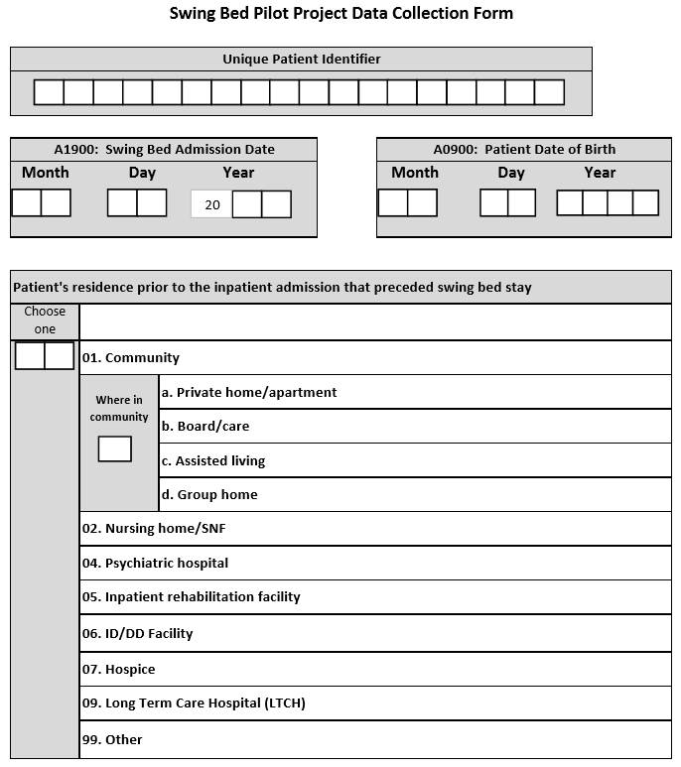
Coding Review and Q&A (10:15 – 11:00)
Unique Patient Identifier as decided by hospital such as act. # or something totally different but you must have a system where you would remember how to access the info and look back at the chart if needed
DOB and SB Adm. Date is self-explanatory
Note:
Most likely, your SB patient will come from your or a referring hospital but the question is asking “ residence prior to the Inpatient Admission that preceded the swing bed stay” CMS did change this from the MDS but we will continue asking it like this because its more relevant to our hospitals.
So, if they came to the hospital as a patient from any of those other places, then code 02 to 09 which ever applies
99 = not any of the above (ie: prison)
For persons w/intellectual disability
Hospice facility or Home with hospice

Slide 7
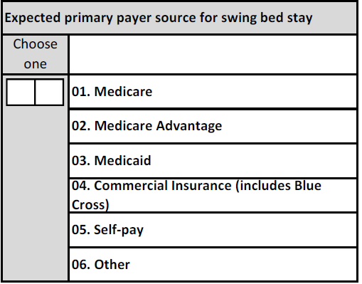
Payor
Medicare = generic/general
Medicare Advantage such as HMO/PPO
Medicaid – only applies if primary (generic or managed care) – not to be used for Medicare/Medicaid – in this case you would choose Medicare
Commercial – all other insurance
Self-pay – self-explanatory
Other = VA, Prison etc…
Such as: VA, Prison
The questions is: what will be the primary payor?

Slide 8
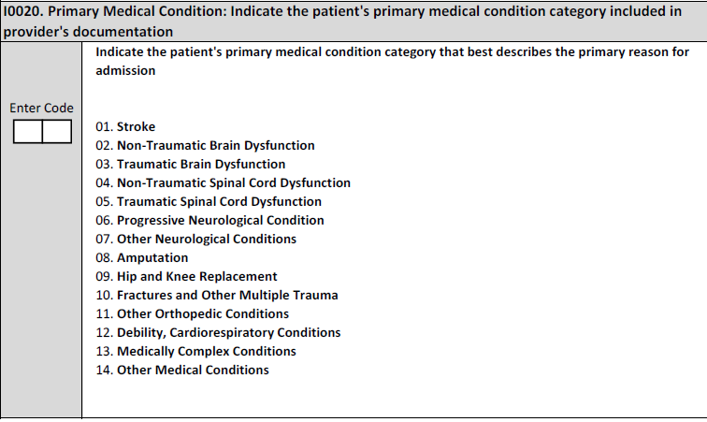
Primary Medical Condition/Reason for SB Admission
Note: PRIMARY medical condition category documented by the provider
Intent: The items in this section are intended to code diseases that have a direct relationship to the patient’s current functional status, cognitive status, mood or behavior status, medical treatments, nursing monitoring, or risk of death. One of the important functions is to generate an updated, accurate picture of the patient’s current health status.
This allows to compare utilization by groups
These are for grouping purpose only – we don’t admit for a stroke but s/p stroke so any type of stroke and sequelae would be “01”
Pay attention to hip & knee replacement vs FX and other multiple trauma - Note: if the hip and knee replacement is secondary to a hip fracture, code as 10, Fractures and Other Multiple Trauma. Example include hip fracture, pelvic fracture, and fracture of tibia and fibula
See future slides for more specific descriptions to help you code in the correct medical condition
Do not use “14” – that will be removed in the next version

Slide 9
Primary Medical Condition/Reason for SB Admission (cont’)
Steps for Assessment
Review the documentation in the medical record to identify the patient’s primary medical condition associated with admission to the facility.
Medical record sources for physician diagnoses include the most recent history and physical, transfer documents, discharge summaries, progress notes, and other resources as available.
Care managers – do not be afraid to discuss with the provider if you do not have all the info you need documented - Providers to update documentation if necessary
Do not hesitate to discuss with your coders
Consider making a list for the provider to check off but remember that is not sufficient - documentation must support the grouping checked off with further documentation on the specific one or more conditions that got them into that grouping
Also remember that these conditions from acute must be something that is still impacting the care in SB
Coding Instructions
Enter the code that represents the primary medical condition that resulted in the patient’s admission – see next 3 slides for coding descriptions. Consider laminating this info to be used as a resource.

Slide 10
Primary Medical Condition/Reason for SB Admission (cont’)
Medical Condition/Reason – Definitions
Code 01, Stroke = if the patient’s primary medical condition category is due to stroke. Examples include ischemic stroke, subarachnoid hemorrhage, cerebral vascular accident (CVA), and other cerebrovascular disease.
Code 02, Non - Traumatic Brain Dysfunction = if the patient’s primary medical condition category is non-traumatic brain dysfunction. Examples include Alzheimer’s disease, dementia with or without behavioral disturbance, malignant neoplasm of brain, and anoxic brain damage.
Code 03, Traumatic Brain Dysfunction = if the patient’s primary medical condition category is traumatic brain dysfunction. Examples include traumatic brain injury, severe concussion, and cerebral laceration and contusion.
Code 04, Non - Traumatic Spinal Cord Dysfunction = if the patient’s primary medical condition category is non-traumatic spinal cord injury. Examples include spondylosis with myelopathy, transverse myelitis, spinal cord lesion due to spinal stenosis, and spinal cord lesion due to dissection of aorta.
Code 05, Traumatic Spinal Cord Dysfunction = if the patient’s primary medical condition category is due to traumatic spinal cord dysfunction. Examples include paraplegia and quadriplegia following trauma.

Slide 11
Primary Medical Condition/Reason for SB Admission (cont’)
Medical Condition/Reason – Definitions (cont’)
Code 06, Progressive Neurological Conditions = if the patient’s primary medical condition category is a progressive neurological condition. Examples include multiple sclerosis and Parkinson’s disease.
Code 07, Other Neurological Conditions = if the patient’s primary medical condition category is other neurological condition. Examples include cerebral palsy, polyneuropathy, and myasthenia gravis.
Code 08, Amputation = if the patient’s primary medical condition category is an amputation. An example is acquired absence of limb.
Code 09, Hip and Knee Replacement = if the patient’s primary medical condition category is due to a hip or knee replacement. An example is total knee replacement. If hip replacement is secondary to hip fracture, code as fracture.
Code 10, Fractures and Other Multiple Trauma , if the patient’s primary medical condition category is fractures and other multiple trauma. Examples include hip fracture, pelvic fracture, and fracture of tibia and fibula.

Slide 12
Primary Medical Condition/Reason for SB Admission (cont’)
Medical Condition/Reason – Definitions (cont’)
Code 11, Other Orthopedic Conditions = if the patient’s primary medical condition category is other orthopedic condition. An example is unspecified disorders of joint.
Code 12, Debility, Cardiorespiratory Conditions = if the patient’s primary medical condition category is debility or a cardiorespiratory condition. Examples include chronic obstructive pulmonary disease (COPD), asthma, and other malaise and fatigue.
Code 13, Medically Complex Conditions = if the patient’s primary medical condition category is a medically complex condition. Examples include diabetes, pneumonia, chronic kidney disease, open wounds, pressure ulcer/injury, infection, and disorders of fluid, electrolyte, and acid-base balance.

Slide 13
Examples of Primary Medical Condition/Reason for SB Admission
Ms. K is a 67-year-old female with a history of Alzheimer’s dementia and diabetes who is admitted after a stroke. The diagnosis of stroke, as well as the history of Alzheimer’s dementia and diabetes, is documented in Ms. K’s history and physical by the admitting physician.
Coding: Would be coded 01, Stroke. I0020B would be coded as I63.411 (Cerebral infarction due to embolism of the right middle cerebral artery).
Rationale: The physician’s history and physical documents the diagnosis stroke as the reason for Ms. K’s admission. The ICD-10 code provided in I0020B above is only an example of an appropriate code for this condition category.
Mrs. E is an 82-year-old female who was hospitalized for a hip fracture with subsequent total hip replacement and is admitted for rehabilitation. The admitting physician documents Mrs. E’s primary medical condition as total hip replacement (THR) in her medical record. The hip fracture resulting in the total hip replacement is also documented in the medical record in the discharge summary from the acute care hospital.
Coding: Would be coded 10, Fractures and Other Multiple Trauma. I0020B would be coded as S72.062 (Displaced articular fracture of the head of the left femur).
Rationale: Medical record documentation demonstrates that Mrs. E had a total hip replacement due to a hip fracture and required rehabilitation. Because she was admitted for rehabilitation as a result of the hip fracture and total hip replacement, Mrs. E’s primary medical condition category is 10, Fractures and Other Multiple Trauma. The ICD-10 code provided in I0020B above is only an example of an appropriate code for this condition category.

Slide 14
Examples of Primary Medical Condition/Reason for SB Admission
Mrs. H is a 78-year-old female with a history of hypertension and a hip replacement 2 years ago. She was admitted to an extended hospitalization for pancreatitis. She had a central line placed during the hospitalization so she could receive TPN (total parenteral nutrition). She also received regular blood glucose monitoring and treatment with insulin when she became hyperglycemic. During her SNF stay, she is being transitioned from being NPO (nothing by mouth) and receiving her nutrition parenterally to being able to tolerate oral nutrition. The hospital discharge diagnoses of pancreatitis, hypertension, and malnutrition were incorporated into Mrs. H’s SNF medical record.
Coding: Would be coded 13, Medically Complex Conditions would be coded as K85.00 (Idiopathic acute pancreatitis without necrosis or infection).
Rationale: Mrs. H had hospital care for pancreatitis immediately prior to her SNF stay. Her principal diagnosis of pancreatitis was included in the summary from the hospital. The surgical placement of her central line does not change her care to a surgical category because it is not considered to be a major surgery.

Slide 15
Prior Surgery within the last 100 Days
CMS had clarified Criteria for major surgery in the MDS instructions as follows: – must meet all 3:
patient was an inpatient in an acute care hospital for at least one day in the 100 days prior to admission to the skilled nursing facility (SNF) (Note – if patient had hip replacement as a SDS (more frequent now) then for some reason had to be admitted soon thereafter for 3 days – we would consider this as meeting the criteria for major surgery
patient had general anesthesia during the procedure, and
Surgery carried some degree of risk to the patient’s life or the potential for severe disability

Slide 16
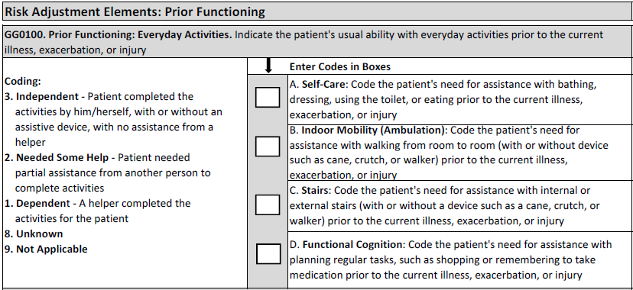
Prior Functioning – Before Hospital Admission
Record the patient’s usual ability to perform self-care, indoor mobility (ambulation), stairs, and functional cognition prior to the current illness, exacerbation, or injury.
(3) - Independent – NO Assistance from a helper
(2) Needed some help – self-explanatory
(1) Dependent – a helper is a must
(8) Unknown – only to be used if the patient cannot say and there are no family/friends… who can inform us and the medical record does not have the information
Not applicable – one would expect that you would have a code 1, 2 or 3 for (A) self-care because that is a must but feasible that you would have N/A for ambulation and stairs if the patient does not do that. Same goes for functional cognition – so, If the patient was unable to do the everyday activity prior to admission to acute, code as 9, Not Applicable

Slide 17
Prior Device Use – Before Hospital Admission
Any mechanical, sit-to-stand, stand assist, full body lifts , chair lift, stair chair
Any type – does not include canes
Note: Devices & aids that the patient used prior to being admitted to acute for the current illness/medical condition
If patient was not using a device prior to hospitalization but was given a walker or w/c during the acute stay for his/her ambulation – the answer would be “Z” none of the above
If the patient was using a walking cane, then check “Z” – none of the above

Slide 18
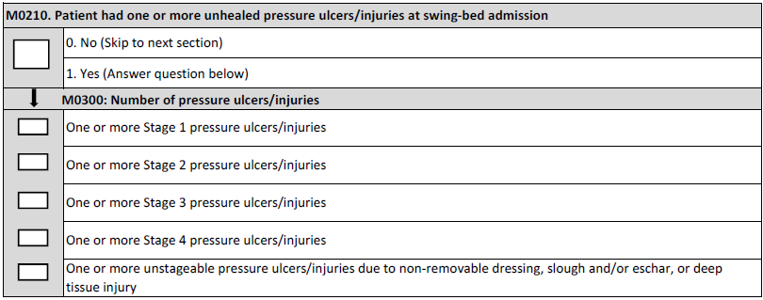
Unhealed Pressure Ulcer/Injury
Reference from MDS the manual
• Stage 1 and deep tissue injuries are called “pressure injuries because wounds are closed”
• Stage 2, 3, or 4 or unstageable due to slough or eschar are termed “pressure ulcers” since they are usually open wounds
• Unstageable due to non-removable dressing or device use “pressure ulcer/injury” since could be open or closed
Note: all refers to deep tissue injury so a skin tear would not constitute a pressure ulcer/injury

Slide 19
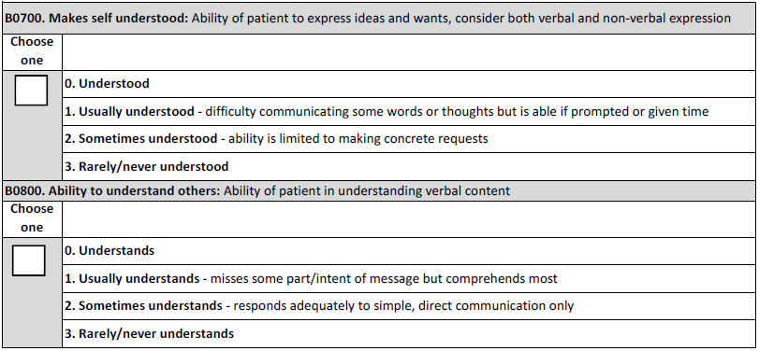
Understand/Understood
which includes writing, pointing, sign language, and cue cards.
Note: clearly read the definitions – this is not assessing speaking, language or hearing – for instance, the patient does not have to be able to speak everything to be understood or usually understood if they can sign or point and/or write or need a translator.

Slide 20
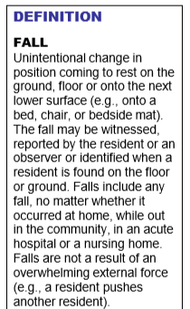
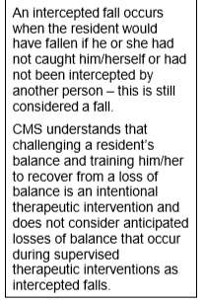
Falls
Falls could have occurred at home, community, NH, etc or while an IP in acute.
Have we updated our “Fall description” to reflect CMS’ definition

Slide 21
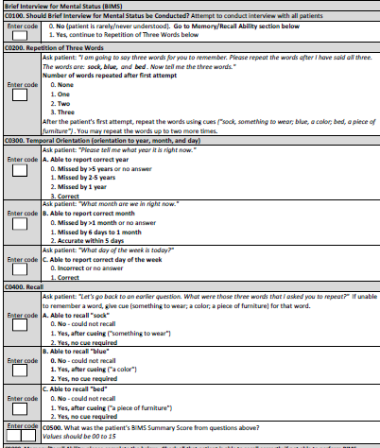
Cognitive
Note: BIMS (Brief Interview for Mental Status) should be attempted on all patients except those who are never/rarely understood
Staff must follow instructions exactly as on the tool reflects to administer BIMS
Skip to Memory/Recall only if patient cannot do BIMS
Memory/Recall section is skipped if BIMS was administered

Slide 22
Cognitive (cont’)
The items in this section are intended to determine the patient’s attention, orientation and ability to register and recall new information. These items are crucial factors in many care-planning decisions.
This information identifies if the interview will be attempted.
Most patients are able to attempt the Brief Interview for Mental Status (BIMS).
A structured cognitive test is more accurate and reliable than observation alone for observing cognitive performance.
Without an attempted structured cognitive interview, a patient might be mislabeled based on his or her appearance or assumed diagnosis.
Structured interviews will efficiently provide insight into the patient’s current condition that will enhance good care.

Slide 23
Cognitive (cont’)
Steps for Assessment
Who ever does the BIMS assessment MUST be trained whether it is the D/C planner, SLP or patient’s nurse
Interact with the patient using his or her preferred language. Be sure he or she can hear you and/or has access to his or her preferred method for communication. If the patient appears unable to communicate, offer alternatives such as writing, pointing, sign language, or cue cards.
Determine if the patient needs or wants an interpreter. • If so, complete the interview with an interpreter.
Determine if the patient is rarely/never understood verbally, in writing, or using another method. If rarely/never understood, skip to C0900 – Memory / Recall
Coding Tips • Attempt to conduct the interview with ALL patients. This interview is preferably conducted after at least 3-4 days days in SB to make sure it does not reflect remnants of the IP acute stay affected by the recent surgery or the transfer which is most likely short term.

Slide 24
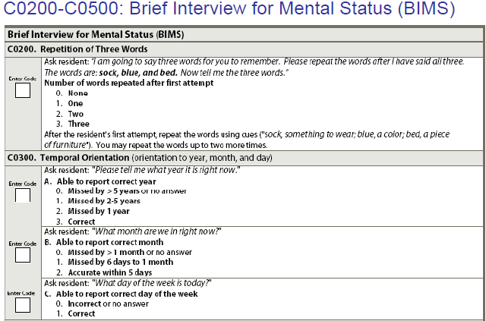
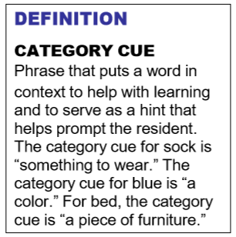
Cognitive (cont’)
The items in this section are intended to determine the patient’s attention, orientation and ability to register and recall new information. These items are crucial factors in many care-planning decisions and used as a risk adjuster.

Slide 25
Cognitive (cont’)
Steps for BIMS Assessment – MUST BE FOLLOWED
Ask the patient each of the 3 questions in Item C0300 separately.
Say to the patient: “I am going to say three words for you to remember. Please repeat the words after I have said all three. The words are: sock, blue, and bed.” Interviewers need to use the words and related category cues as indicated. If the interview is being conducted with an interpreter present, the interpreter should use the equivalent words and similar, relevant prompts for category cues.
Immediately after presenting the three words, say to the patient: “Now please tell me the three words.” - If the patient specifically asks for clues, respond by saying, “I need to know if you can answer this question without any help from me.”
After the patient’s first attempt to repeat the items:
If the patient correctly stated all three words, say, “That’s right, the words are sock, something to wear; blue, a color; and bed, a piece of furniture” [category cues].
Category cues serve as a hint that helps prompt patients’ recall ability. Putting words in context stimulates learning and fosters memory of the words that patients will be asked to recall in item C0400, even among patients able to repeat the words immediately.
If the patient recalled two or fewer words, say to the patient: “Let me say the three words again. They are sock, something to wear; blue, a color; and bed, a piece of furniture. Now tell me the three words.” If the patient still does not recall all three words correctly, you may repeat the words and category cues one more time.
If the patient does not repeat all three words after three attempts, re-assess ability to hear. If the patient can hear, move on to the next question. If he or she is unable to hear, attempt to maximize hearing (alter environment, use hearing amplifier) before proceeding

Slide 26
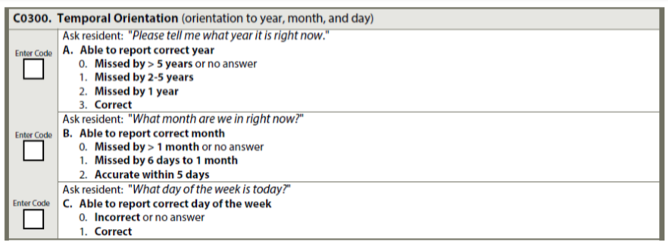
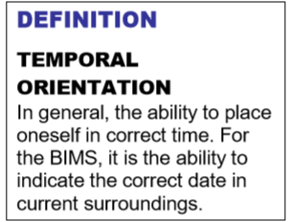
Cognitive (cont’)
Ask the patient each of the 3 questions in Item C0300 separately.
Allow the patient up to 30 seconds for each answer and do not provide clues.
If the patient specifically asks for clues (e.g., “is it bingo day?”) respond by saying, “I need to know if you can answer this question without any help from me.”
Use Flash Cards from the tool kit as necessary

Slide 27
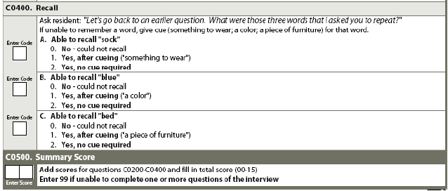
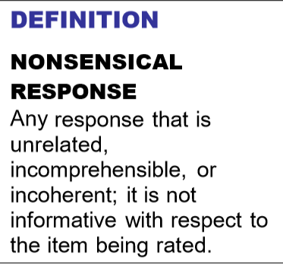
Cognitive (cont’)
Ask the patient the following: “Let’s go back to an earlier question. What were those three words that I asked you to repeat?”
Allow up to 5 seconds for spontaneous recall of each word.
For any word that is not correctly recalled after 5 seconds, provide a category cue. Category cues should be used only after the patient is unable to recall one or more of the three words.
Allow up to 5 seconds after category cueing for each missed word to be recalled.
If on the first try (without cueing), the patient names multiple items in a category, one of which is correct, they should be coded as correct for that item.
If, however, the interviewer gives the patient the cue and the patient then names multiple items in that category, the item is coded as could not recall, even if the correct item was in the list.

Slide 28
Cognitive (cont’)
Steps for Assessment
This section is completed only if the patient was not able to take the BIMS test
Ask the patient about each item. For example,
“What is the current season? Is it fall, winter, spring, or summer?”
“What is the name of this place?”
If the patient is not in his or her room, ask, “Will you show me to your room?” Observe the patient’s ability to find the way.
For patients with limited communication skills, in order to determine the most representative level of function, ask direct care staff across all shifts and family or significant other about recall ability.
Ask whether the patient gave indications of recalling these subjects or recognizing them during the look-back period.
Observations should be made by staff across all shifts and departments and others with close contact with the patient.
Review the medical record for indications of the patient’s recall of these subjects during the look-back period

Slide 29
Cognitive (cont’)
Coding Instructions for Memory/Recall
For each item that the patient recalls, check the corresponding answer box. If the patient recalls none, check none of above.
Check current season: if patient is able to identify the current season (e.g., correctly refers to weather for the time of year, legal holidays, religious celebrations, etc.).
Check location of own room: if patient is able to locate and recognize own room. It is not necessary for the patient to know the room number, but he or she should be able to find the way to the room.
Check staff names and faces: if patient is able to distinguish staff members from family members, strangers, visitors, and other patients. It is not necessary for the patient to know the staff member’s name, but he or she should recognize that the person is a staff member and not the patient’s son or daughter, etc.
Check that he or she is in a hospital swing bed: if patient is able to determine that he or she is currently at the hospital for something describe as rehab, a bed at the hospital to work on getting better before going home etc.. , in skilled care, in a swing bed etc..
Check none of above was recalled if that is the case

Slide 30
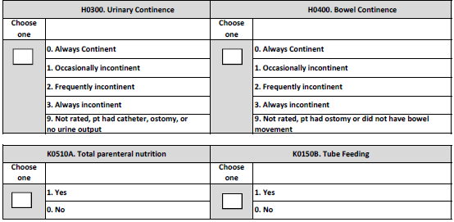
Urinary/Bowel Incontinence – TPN/Tube Feeding
Note:
Urinary/Bowel section may need all 3 days to assess – may not be able to determine in 1 or 2 days.
TPN and Tube feeding only applies if present or initiated during the SB stay – not to be counted if discontinued before SB admission

Slide 31
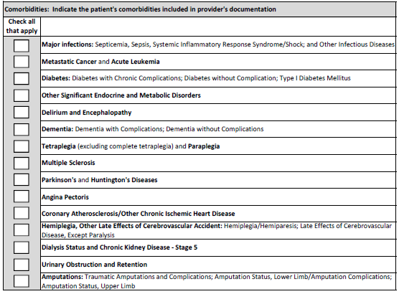
Comorbidities
Note:
Comorbidities documented by the provider in H&P or progress notes
Must be active – hx of if not impacting the treatment plan is not to be checked off
Ok to discuss with the provider if obvious comorbidity but provider did not document

Slide 32
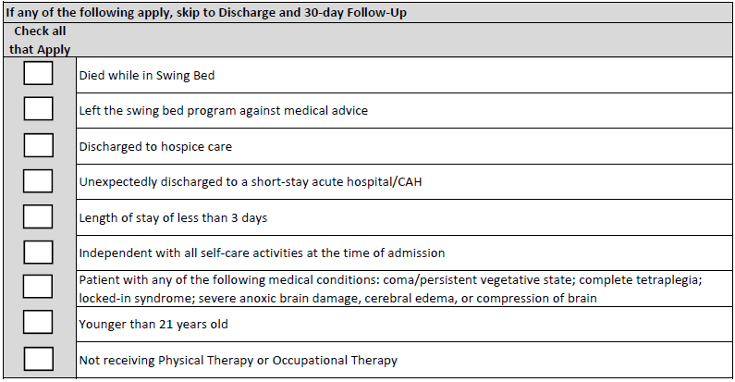
Exceptions to Full Assessment
Self Care & Mobility Data will be completed for all payors minus the following exceptions:
Regardless of hospice facility, unit, bed, home with hospice
Still an exception if receiving PT for wound debridement only!
If none of the above applies then complete the self care & mobility assessments

Slide 33
Function/Mobility Sections
Admission assessment must be completed within 3 calendar days of admission (including day of admission)
Coding on admission should reflect the person’s baseline admission functional status and is based on a clinical assessment.
The admission functional assessment, when possible, should be conducted prior to the person benefitting from treatment interventions in order to determine a true baseline functional status on admission.
Treatment should not be withheld in order to conduct the functional assessment.
Activities may be completed with (if they usually use a device or safer attempted with a device) or without assistive device(s). Coding is not based on devices.
Patients with cognitive impairments/limitations may need physical and/or verbal assistance when completing an activity. Code based on the patient’s need for assistance to perform the activity safely (for example, choking risk due to rate of eating, amount of food placed into mouth, risk of falling). These are at the very lease not independent – will be coded a 5 (supervision/set up) or lower

Slide 34
Function/Mobility Sections
If the patient performs the activity more than once during the assessment period and the patient’s performance varies, coding should be based on the patient’s “usual performance,” which is identified as the patient’s usual activity/performance for any of the Self-Care or Mobility activities, not the most independent or dependent performance over the assessment period.
A provider may need to use the entire 3-day assessment period to obtain the patient’s usual performance for all measures ie: patient too tired to complete the assessment on day 1 or weather is bad, and you do not have a car simulator…
Assess the patient’s self-care status based on:
direct observation,
the patient’s self-report,
family reports, and
direct care staff reports documented in the patient’s medical record during the assessment period
CMS anticipates that an interdisciplinary team of qualified clinicians is involved in assessing the patient during the three-day assessment period
CMS defines “Qualified Clinician” as Healthcare professionals practicing within their scope of practice and consistent with Federal, State, local law and regulations”

Slide 35
Function/Mobility Sections (cont’)
This should not be a therapy only assessment – should be what the patient’s usual performance is since admission on all shifts – not just what they did with therapy
Ideally this is a stand-up meeting the day after all admission assessments have been completed - with SB Coordinator, nursing and therapy rep that know the patients at which time each item is discussed, and levels agreed to. Night shift should include patient’s functional status at the morning report to get the full picture
Read the description of the items to be coded very carefully – do not read into it more than its asking (see later examples) – Must be able to perform all aspects of the described items to be considered Independent.
Carefully read the coding key descriptions and choose what best fits the patient – always look at the descriptions before and after the one you think it is to make sure you have the correct one
All assessment items must be attempted to be coded – otherwise a reason for no attempt must be coded (see slides on “Exceptions”)
See attachments for Coding Examples, Probing Question Examples etc…

Slide 36
Basic CMS Guidelines to Coding Function & Mobility
When coding the patient’s usual performance, “effort” refers to the type and amount of assistance the helper provides in order for the activity to be completed. The 6-point rating scale definitions include the following types of assistance: setup/cleanup, touching assistance, verbal cueing, and lifting assistance.
06 - Independent ‐ Patient completes the activity by him/herself with no assistance from a helper
05 - Setup or clean‐up assistance ‐ Helper sets up or cleans up; patient completes activity. Helper assists only prior to or following the activity

Slide 37
Basic CMS Guidelines to Coding Function & Mobility
04 - Supervision or touching assistance ‐ Helper provides verbal cues and/or touching/steadying and/or contact guard assistance as patient completes activity. Assistance may be provided throughout the activity or intermittently
03 - Partial/moderate assistance ‐ Helper does LESS THAN HALF the effort. Helper lifts, holds, or supports trunk or limbs, but provides less than half the effort
02 - Substantial/maximal assistance ‐ Helper does MORE THAN HALF the effort. Helper lifts or holds trunk or limbs and provides more than half the effort
01 - Dependent ‐ Helper does ALL of the effort. Patient does none of the effort to complete the activity. Or, the assistance of 2 or more helpers is required for the patient to complete the activity

Slide 38
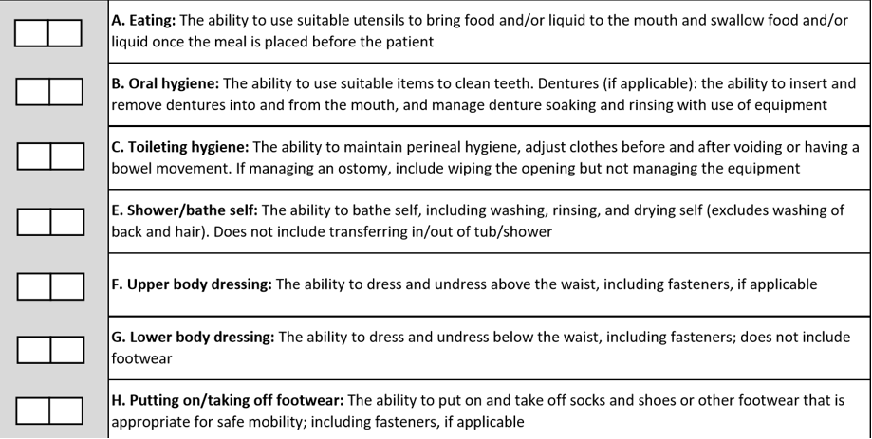
Self Care & Mobility Items To Be Coded

Slide 39
Coding Tips
Coding Tips for – Eating
Assesses eating and drinking by mouth only
Assistance with tube feedings or TPN is not considered when coding Eating.
If the patient does not eat or drink by mouth and relies solely on nutrition and liquids through tube feedings or TPN because of a new (recent-onset) medical condition but with plans to D/C at a point, code as 88, Not attempted due to medical condition or safety concerns.
If the patient did not eat or drink by mouth prior to the current illness, injury, or exacerbation, code eating as 09, Not applicable
For patients who have a combination of oral and tube feeding, eating should be coded on the amount of assistance the patient requires to eat and drink by mouth
If the patient eats finger foods with his or her hands, code based upon the amount of assistance provided

Slide 40
Coding Tips
Coding Tips for – Toileting Hygiene
This item pertains to both voiding and/or having a bowel movement
Toileting hygiene includes managing undergarments, clothing, and incontinence products and performing perineal cleansing before and after voiding or having a bowel movement.
Hygiene tasks can take place before and after use of the toilet, commode, bedpan, or urinal
If the patient does not usually use undergarments, then assess the patient’s need for assistance to manage lower-body clothing and perineal hygiene.
If the patient has indwelling catheter and has bowel movements, code the toileting hygiene based on the assistance needed by the patient when moving his or her bowels
If the patient completes a bladder or bowel in bed, code Toileting hygiene based on the patient’s need for assistance in managing clothing and perineal cleansing.

Slide 41
Coding Tips
Coding Tips for – Shower/Bath Self
Assessment can take place in a shower or bath, at a sink, or at the bedside (i.e., full body sponge bath)
Shower/bathe self includes the ability to wash, rinse, and dry the face, upper and lower body, perineal area, and feet. Do not include washing, rinsing, and drying the patient’s back or hair.
Shower/bathe self does not include transferring in/out of a tub/shower.
If the patient bathes himself or herself and a helper sets up materials for bathing/showering, then code as 05, Setup or clean-up assistance.
If the patient cannot bathe his or her entire body because of a medical condition, then code Shower/bathe self based on the amount of assistance needed to complete the activity

Slide 42
Coding Tips
Coding Tips for – Upper & Lower Body Dressing
The following items are considered a piece of clothing when coding the dressing items:
Other upper body dressing examples: thoracic-lumbar-sacrum orthosis (TLSO), abdominal binder, back brace, stump sock/shrinker, upper body support device, neck support, hand or arm prosthetic/orthotic.
Other lower body dressing examples: knee brace, elastic bandage, stump sock/shrinker, lower-limb prosthesis. o Footwear examples: ankle-foot orthosis (AFO), elastic bandages, foot orthotics, orthopedic walking boots, compression stockings (considered footwear because of dressing don/doff over foot).

Slide 43
Coding Tips
Coding Tips for – Upper Body Dressing
Includes bra, undershirt, button-down shirt, pullover shirt, dresses, sweatshirt, sweater, nightgown (NOT hospital gown), and pajama top
If the patient dresses himself or herself and a helper retrieves or puts away the patient’s clothing, then code 05, Setup or clean-up assistance.
Helper assistance with buttons and/or fasteners is considered touching assistance = 04
For both upper & lower - If donning and doffing an elastic bandage, elastic stockings, or an orthosis or prosthesis occurs while the patient is dressing/undressing, then count the elastic bandage/elastic stocking/orthotic/prosthesis as a piece of clothing when determining the amount of assistance the patient needs when coding the dressing item.

Slide 44
Coding Tips
Coding Tips for – Lower Body Dressing
Helper assistance with buttons and/or fasteners is considered touching assistance = 04
Includes underwear, incontinence brief, slacks, short, capri pants, pajama bottoms, and skirts
Other examples: knee brace, elastic bandage, stump sock/shrinker, lower-limb prosthesis

Slide 45
Coding Tips
Coding Tips - Putting on/taking off Footwear
Includes socks, shoes, boots, and running shoes
Other examples: ankle-foot orthosis (AFO), elastic bandages, foot orthotics, orthopedic walking shoes, compression stocking (on and off over foot) – Amputees may not have footwear as shoe attached
For patients with bilateral lower extremity amputations with or without use of prostheses, the activity of putting on/taking off footwear may not occur. For example, the socks and shoes may be attached to the prosthesis associated with the upper or lower leg.
If the patient performed the activity of putting on/taking off footwear immediately prior to the current illness, exacerbation, or injury, code as 88, Not attempted due to medical condition or safety concerns.
If the patient did not perform the activity of putting on/taking off footwear immediately prior to the current illness, exacerbation, or injury because the patient had bilateral lower-extremity amputations and the activity of putting on/taking off footwear was not performed during the assessment period, code as 09, Not applicable
For patients with a single lower extremity amputation with or without use of a prosthesis, the activity of putting on/taking off footwear could apply to the intact limb or both the limb with the prosthesis and the intact limb.
If the patient performed the activity of putting on/taking off footwear for the intact limb only, then code based upon the amount of assistance needed to complete the activity.
If the patient performed the activity of putting on/taking off footwear for both the intact limb and the prosthetic limb, then code based upon the amount of assistance needed to complete the activity.

Slide 46
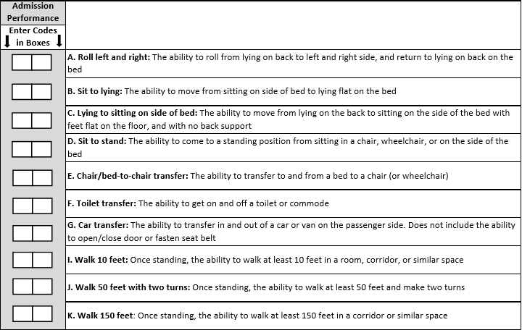
Self Care & Mobility Items To Be Coded (cont’)
Lying flat on bed at level normal for that pt.
Flat on floor or on stool if bed cannot be adjusted

Slide 47
Coding Tips
Coding Tips for – Rolling Left and Right
Patient demonstrates being able to lie on back and turn left, return to back and turn to right then return to the back – must be able to do both w/out assistance – if he can do 1 side but not the other, level at how much assistance did you have to give.
If can go one side but not the other due to pain or tubes etc then put 88
Coding Tips for – Sitting to Lying Flat
Lying Flat = to what is usual for that patient – if they need bed up at 30 % due to breathing issues then that is “their flat”
Coding Tips for - Lying to Sitting on Side of Bed
Lying to sitting on side of bed, indicates that the patient transitions from lying on his/her back to sitting on the side of the bed with feet flat on the floor and sitting upright on the bed without back support.
The clinician is to assess the patient’s ability to perform each of the tasks within this activity and determine how much support the patient requires to complete the activity.
Clinical judgment should be used to determine what is considered a “lying” position for that patient.
If the patient’s feet do not reach the floor upon lying to sitting, the clinician will determine if a bed height adjustment or a foot stool is required to accommodate foot placement on the floor/footstool.
Back support refers to an object or person providing support of the patient’s back.

Slide 48
Coding Tips (cont’)
Coding Tips for – Chair/Bed-to-Chair
Chair/bed-to-chair transfer, begins with the patient sitting in a chair or wheelchair or sitting upright at the edge of the bed and returning to sitting in a chair or wheelchair or sitting upright at the edge of the bed.
The activities of “Sit to lying” and “Lying to sitting” on the side of the bed are two separate activities that are not assessed as part of “Chair/Bed-to-Chair”
If a mechanical lift is used to assist in transferring a patient for a chair/bed-to-chair transfer and two helpers are needed to assist with a mechanical lift transfer, then Code 01 - Dependent, even if the patient assists with any part of the chair/bed-to-chair transfer by holding the railing etc….

Slide 49
Coding Tips (cont’)
Coding Tips for Car Transfers
The Car transfer item includes the patient’s ability to transfer in and out of the passenger seat of a car or car simulator.
For item regarding car transfer, use of an indoor car can be used to simulate outdoor car transfers.
These half or full cars would need to have similar physical features of a real car for the purpose of simulating a car transfer, that is, a car seat within a car cabin.
The Car transfer item does not include transfers into the driver’s seat, opening/closing the car door, fastening/unfastening the seat belt.
In the event of inclement weather or if an indoor car simulator or outdoor car is not available during the entire 3-day assessment period, then use code 10, Not attempted due to environmental limitations.
If at the time of the assessment the patient is unable to attempt car transfers and could not perform the car transfers prior to the current illness, exacerbation or injury, code 09, Not applicable. But, if the patient could get in and out of a car prior to the hospitalization but unsafe to try now due to mobility limitation, then cade “88” - unsafe

Slide 50
Items To Be Coded (cont’)
Coding Tips for Walking
Walking activities do not need to occur during one session.
Allowing a patient to rest between activities or completing activities at different times during the day or on different days may facilitate completion of the activities.
When coding walking items, do not consider the patient’s mobility performance when using parallel bars.
Parallel bars are not a portable assistive device.
If safe, assess and code walking using a portable walking device when needed.
The turns are 90-degree turns.
The turns may be in the same direction (two 90-degree turns to the right or two 90-degree turns to the left) or may be in different directions (one 90-degree turn to the left and one 90-degree turn to the right).
The 90-degree turn should occur at the person’s ability level and can include use of an assistive device (for example, cane).

Slide 51
Coding Tips
Walk 10 feet: Once standing, the ability to walk at least 10 feet in a room, corridor, or similar space
Note: Does the patient walk? Mr. Z currently does not walk, but a walking goal is clinically indicated.
Coding: 88 due to clinically unsafe on admission
But it would be 09 N/A if he did not walk prior to his acute admission stay. Same goes to walking 50 ft and 150 ft.
If unsafe to walk 10 ft. on admission (88) then code the same for 50 ft with 2 turns and 150 ft.
If able to walk 10 ft then attempt 50 ft to code unless its clear that 10 ft is the max to be walked safely and put 88 for the next 2 levels
Walk 50 feet with two turns: Once standing, the ability to walk a total of at least 50 feet (1 way or go and return) and make two turns (left and right or 2 lefts and 2 rights)
Walk 150 feet: Once standing, the ability to walk at least 150 feet in a corridor or similar space (again 1 way or go and return)

Slide 52
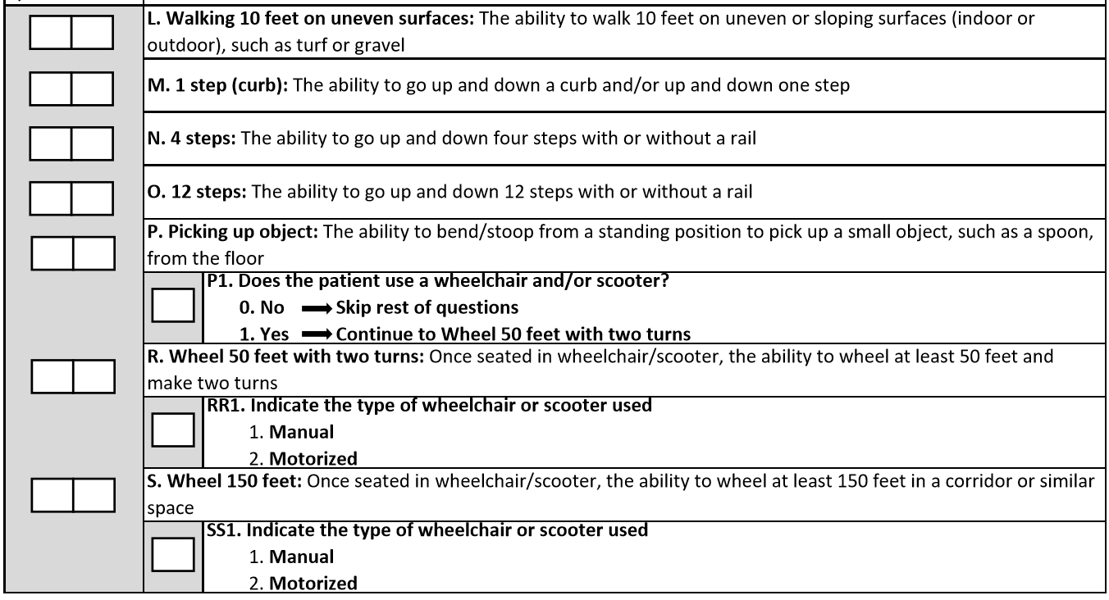
Coding Tips (cont’)
See note below
May use a step of 4 x 3
Also applies to picking up from a wheelchair

Slide 53
Items To Be Coded (cont’)
Walking 10 feet on uneven surfaces: The ability to walk 10 feet on uneven or sloping surfaces (indoor or outdoor), such as turf or gravel
1 step (curb): The ability to go up and down a curb and/or up and down one step
4 steps: The ability to go up and down four steps with or without a rail
12 steps: The ability to go up and down 12 steps with or without a rail – reportedly CMS noted that a 4-step x 3 up and down will pass for a 12 step
Picking up object: The ability to bend/stoop from a standing position to pick up a small object, such as a spoon, from the floor – may be picking object from a W/C if the patient is W/C bound – remember that it is ok if they need a reacher to pick up the object – we are not measuring the need for device or not
Wheel 50 feet with two turns: Once seated in wheelchair/scooter, the ability to wheel at least 50 feet and make two turns (see description of 90 degree turn on previous slide)
Wheel 150 feet: Once seated in wheelchair/scooter, the ability to wheel at least 150 feet in a corridor or similar space

Slide 54
Coding Tips (cont’)
The intention of the wheelchair items is to assess the patient’s use of a wheelchair for self-mobilization at admission and discharge when appropriate.
The clinician uses clinical judgment to determine if the patient’s use of a wheelchair is appropriate for self-mobilization due to the patient’s medical condition or safety.
If the patient walks and is not learning how to mobilize in a wheelchair, and only uses a wheelchair for transport between locations within the facility, code the wheelchair/scooter gateway items at admission and/or discharge items as follows: Does the patient use a wheelchair/scooter = 0 for No.
Answering the question in this way invokes a skip pattern which will skip all remaining wheelchair questions.
Otherwise said, only code wheelchair mobility based on an assessment of the patient’s need and ability to mobilize in the wheelchair.
Remember that it is very possible that the patient starts with a wheelchair but no longer is the case on discharge – only walking will apply at discharge.

Slide 55
Coding Function & Mobility - Exceptions
All functions must be attempted unless there is a reason why not as follows: Note: It is expected that the documentation in the chart supports reasons for not assessing all items. So, when using any of these exception code, there should be documented to back up the reason for not assessing.
07 - Patient refused – do all possible to convince them to participate
09 - Not applicable ‐ Not attempted and the patient did not perform this activity prior to the current illness, exacerbation, or injury – for instance, if patient was not doing stairs before then its NA, if patient does not ambulate or uses w/c in community then those items are NA etc…
10 - Not attempted due to environmental limitations (e.g., lack of equipment, weather constraints) – for example, there are no 12-step stairs in the hospital (gym or stairs between hospital floors etc… Remember that if the weather is not good to test outdoors on day 1, do not use “not attempted due to environmental limitations” unless the weather does not change for all 3 days
88 - Not attempted due to medical condition or safety concerns – for instance you may not be able to assess stairs within the 1st 3 days for post stroke, or maybe their medical issues are still not sufficiently stable to attempt some of the testing

Slide 56
Function/Mobility Sections (Discharge)
Same items will be tested on discharge
Must be completed within 3 calendar days of discharge including the day of discharge
For the Discharge assessment, code the patient’s discharge functional status, based on a clinical assessment of the patient’s performance that occurs as close to the time of the patient’s discharge as possible to capture all areas of improvement possible
Usually done the day prior or day of the discharge at a stand-up mtg
Same coding principles apply to discharge assessments
Again, all assessment items must be attempted to be coded – otherwise a reason for no attempt must be coded
Patients should be allowed to perform activities as independently as possible for both admission and discharge, as long as they are safe for both admission & discharge assessments.
Remember that even if patient was coded on admission as 07 (refused) or 10 (environmental issue) does not mean it is automatically the same at discharge

Slide 57
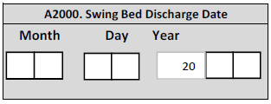
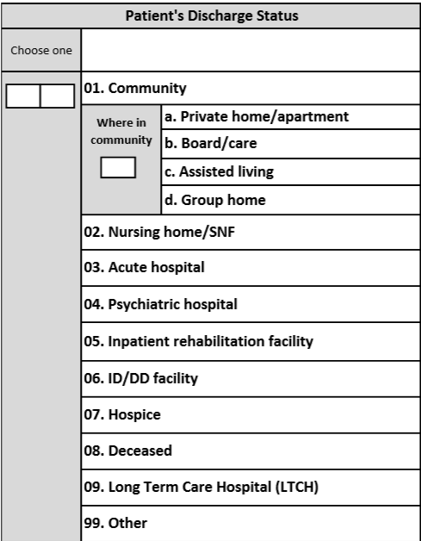
Discharge Data
Self explanatory but make sure you have a good system to enter this info for instance both D/C to home and Home with HH would be coded 01
Be sure to close a record by discharging them if they are returned to acute from SB. So, if returned to SB after acute – you should have 2 admissions & D/C record on this one patient.

Slide 58
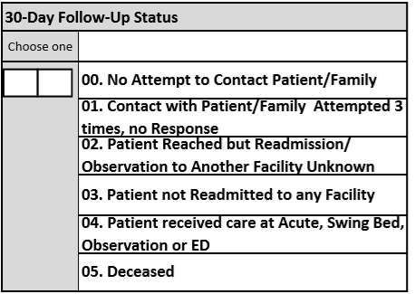
30-Day Follow-up Status
Not only is having a follow-up call system the right thing to do to prevent readmissions but demonstrating a low readmission rate after SB vs SNF will help to make a “decreased cost” point.
We understand that getting information regarding a hospital use other than yours may be difficult to get information from the patient hence all the choices on the next Slide. – We do expect that you will be able to get info from HIM for patients who used your CAH at a minimum
Managing care from acute or post-acute requires follow-up calls done within 24-72 hrs post discharge based on condition, then weekly or more if issues were identified but no less than 30 days post discharge for the 30 day post discharge window closing and data collection
Does require having good processes in place informing the patient/family of the follow-up call, ensuring we have the correct # to call and preferred times including what # they should expect would show up on their phone

Slide 59
Who Should We Conduct Follow-Up Calls For?
A post-discharge for this project should be done for every discharges including:
Those who left the SB AMA (against medical advice)
SB LOS less than 3 days
Independent with all self-care activities at the time of admission
Regardless of whether they received PT and/or OT
Those discharged to a nursing home (we need to know the outcome of those patients also)
Post-discharge for this project will not be called if the following exceptions exist:
Died while on the unit or you are aware that they passed after being discharged
Discharged to hospice care
Unexpected D/C to a short-stay acute hospital/CAH because the hospital may do their own follow-up
Patients in coma/persistent vegetative state etc (as per exception list)

Slide 60
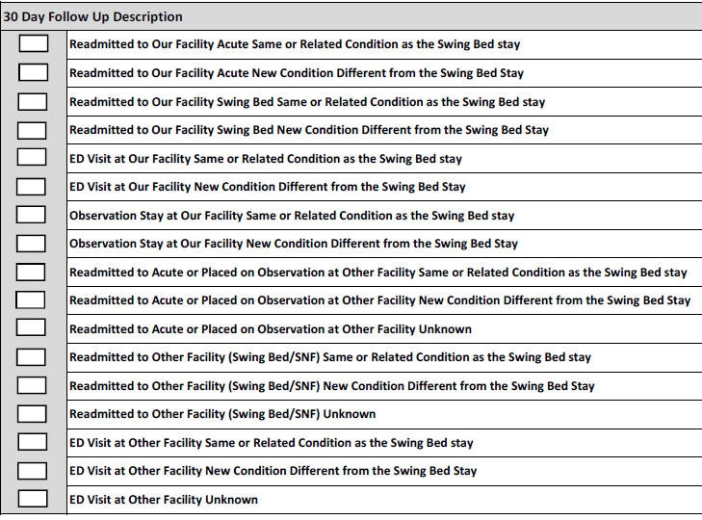
30-Day Follow-up Status
Check all that applies
Take the time to read every options
We hope to make this list less cumbersome for the next update.

Slide 61
Coding Q&A?
Q: Do we have to have data on every admissions?
A: Yes, every admissions must be entered and all sections of the assessment to be coded up to the part of Exclusions. If exclusions apply, then skip to D/C and Follow-up items.
****************************************************************
Q: What if the patient was discharged unexpectedly and we only had time to do 4 of the sections?
A: Complete what you can based on documentation including the Exception section.
*****************************************************************
Q: What if a patient had therapy but it only started on day 4 or 5, how do I document the admission Functional Assessment
A: Team members who worked with the patient such as nurses and SB Coordinator must complete the Functional Assessment by the end of Day 3
There may be more “88” then if therapy was involved because nursing does not feel comfortable assessing and may be a reason why therapy was requested.
*************************************************************

Slide 62
Coding Q&A?
Q: What if we did the admission functional assessment and entered the data in the system but the patient dies on day 5 which now puts him on the exclusion list – do I erase the functional data
A: No need to go back and erase – complete the Exception list – the program will ignore the functional data already inputted
*************************************************************************
Q: Patient is nourished 100% via g-tube but the plan is to work with him to have at least partial oral feeding or removal of the g-tube by discharge
A: Code as 88 = unsafe and code status on discharge
Q: What if the patient is 50% g-tube and 50% oral?
A: Code based on the 50% oral intake
************************************************************************
Q: Patient has had a stroke and can barely walk for a few steps safely, but the plan is to work with him to walk before D/C – do I code 88 (unsafe) or 1 (dependent) for 10 ft, 50 ft and 150 ft
A: Code 88 unless safe enough to complete 10 ft with max-assist of 1 or 2 staff in which case you would code level 1 or 2

Slide 63
Coding Q&A?
Q: How do I code if the patient was able to do 10 ft with a staff member by his side and another following with a w/c in case he needs to sit down, how do I code “walk 10 ft”
A: Code as 01 = Dependent (because 2 staff members were needed)
*************************************************************************
Q: Patient has significant SOB but able to walk up to 10 feet with helper doing more than ½ of the effort – how do I code walk 10, 50 ft and 150 feet?
A: Code 10 ft as 02 = Substantial/Maximum Assist
Code 50 ft and 150 ft as 88
*************************************************************************
Q: We have a patient status post car accident who has a lot of pain when turning in bed. When assessing roll left and right (The ability to roll from lying on back to left and right side and return to lying on back on the bed) The patient needs max assist of 1 to turn to the left but has too much pain to be turned to his right side. Do we code this measure a “2” – max assist?
A: No, code as 88 – you were not able to complete the full assessment

Slide 64
Coding Q&A?
Q: A patient is receiving medical care and rehab until day 8 at which time the therapy staff discharges the patient from their services since he has met his rehab goals but remains on the unit until day 13 to complete IV antibiotic. When is the D/C assessment completed? Based on day 6-7-8 or 11-12-13 functional level?
A: Based on day 11-12-13 (preferably measured on day 12 or 13)
******************************************************************
Q: A patient is admitted late Friday pm for medical issues and rehab. There are no therapists working on the weekend hence patient will have been in the program for 3 days (Fri-Sat-Sun) before a therapy assessment. Do we still code the admission assessment, or do we take the info from Monday’s therapy assessment?
A: Nursing will be responsible to do the admission functional assessment – If you wait for Monday am for the SB Coord to coordinate, base info on nursing assessments, documentation and interview as needed – again may be more “88” (unsafe to assess) – Therapy and nursing will be involved in the D/C assessment

Slide 65
Coding Q&A?
Q: Patient is admitted for medical issues/treatments and the need for skilled therapy was not identified until day 4 or 5 or, the patient was too sick to initiate therapy from day 1. How do we code the admission assessment – do we base it on the first 3 days or from the time therapy was requested?
A: As above, nursing will code the admission functional assessment
*****************************************************************
Q: During the 3 days for assessment, the PT noted the patient to be a level 3 (mod assist – less than ½ performed by helper) for chair/bed-to-chair transfer but the rest of the time the patient is reported to require max assist where the nursing staff must perform more than ½ of the effort as helpers. Do we code chair/bed-to-chair as 2 or 3
A: Code as 2 (max assist) since this what the patient looks like on the average
******************************************************************
Q: A patient had his 3-day assessment but was transferred back to acute care on day 5 with an expected return to SB when stable. We discharged the patient to acute on day 5 therefore this patient will be an exception, so we do not complete the discharge self-care and mobility assessment. After 3 days in acute, he is returned to SB as planned. Do we go from where we left of?
A: We start over since in SB it is considered a new admission

Slide 66
Coding Q&A?
Q: A patient was discharge to acute and did not return to SB. Do we complete a 30-day follow-up?
A: No - acute should be doing a follow-up
******************************************************************
Q: A patient was discharged from acute to SB with a fresh trach and 2 weeks rest from chemo and radiation therapy with a plan to then be readmitted to acute for neck surgery. Do I report this as a readmission to acute though it was planned?
A: No since the planned readmission was documented – the next tool update should include a box to identify “planned readmission”
******************************************************************
Q: A patient was admitted to acute care from an Assisted Living. After the acute care he was discharged to a Transitional Care Unit at that hospital and now he is being transferred to your SB program. How do I code his residence prior to acute?
A: Assisted Living
****************************************************************
Q: Our patient was discharged home with Hospice provided by the local home health, do I code 01 – community or 07 – Hospice?
A: 07 - Hospice

Slide 67
Coding Q&A?
Q: Should I be doing a 30-day follow-up with hospice patients discharged to a hospital, at home or in a facility/unit or NH bed for hospice?
A: No
******************************************************************
Q: Do I do follow-up with patients D/C’ed AMA or < than 3-day stays
A: Yes
******************************************************************
Q: Do we need to complete a 30-day follow up call to patients who were discharged to home (community) but with Home Health?
A: Yes
****************************************************************

Slide 68
Coding Q&A?
Q: Coding data was reported to Stroudwater under a wrong account # - had used the acute act. # vs the SB act. # but I can’t change it. What do I do to correct this
A: Contact Paula Knowlton (pknowlton@Stroudwater.com) at Stroudwater and they will make the correction for you.
******************************************************************
Q: Is there a deadline as to when admissions and discharges must be entered in the web-based system?
A: Deadline is by the 10th of the month following the quarter but recommend by day-5 to give Stroudwater an opportunity to benchmark data, followed by my clinical analysis in order to share with participating hospitals.
Ideally records are completed no later than the week of discharge (except follow-up data) in order to have on-going up to date access to data reporting and making the project more manageable. Never put off tomorrow what you can do today – one never knows what will happen on the last day to enter data!

Slide 69
Examples on How to Code & Other Tools
In addition, review the following updated WORD documents and discuss with staff before they start coding:
Keep this PP presentation and attached documents in the same folder for future staff training needs

Slide 70
Next Step & THANK YOU!
Pull a team together to discuss what was talked about and review the tools.
Let me know of any remaining questions you may have
Determine a plan of who, how, when to orient the rest of the nursing and therapy staff re: Functional Assessment Coding – document their orientation. Ideally develop a competency test
Remember to include training on documentation to support coding
Email Paula Knowlton from Stroudwater at pknowlton@stroudwater.com for any technical questions about the Stroudwater portal
Going forward, do write to me maryguyotconsulting@gmail.com with clinical questions or to share what you would like the web-based tool to be able to do
Writing to Paula or I, PLEASE clarify which hospital you are asking about
Mark Your Calendars – Next WV on-site meeting is for January 29, 2020
If you inputted data for Q4, 2019, you will be getting the benchmarking data slides in advance of the meeting for the team to get together and discuss opportunities for improvement – be ready to share such at the CAH network meeting

