Slide 1
Martinsburg VAMC
Emergency Management
March 31, 2023
Tom Thompson
Emergency Management – Associate Director

Slide 2
Martinsburg VAMC Emergency Management Office Mission
The Martinsburg VAMC Emergency Management Office will prepare, plan, and manage the comprehensive emergency management program; coordinate response and recovery from all-hazard events; strive to increase the safety of patients, staff, and resources; and provide for the continuity of hospital operations in the event of an emergency.

Slide 3
Incident Command Training & Courses
The following positions require completion of the NIMS courses identified below:
Position | IS-100 | IS-200 | ICS-300 | ICS-400 ICS-402 | IS-700 | IS-701A IS-702A IS-703A IS/G-775 | IS-800.b
Supervisors, Psychologists, Social Workers, Physicians, RNs, NPs, PAs, Infection Control Staff, Mental Health Clinicians, Business Managers, Dispatchers | X |  |  |  | X
ICS Team Members, Infection Control Leadership, Service Chiefs, Chief Nurses, Police Officers, Fire Fighters | X | X | X |  | X |  | X
HERT, DECON, DUV, IDIRT, Nursing Officer of the Day (NOD) and above | X | X |  |  | X |  | X
QUAD, Fire & Police Chief | X | X | X | X | X |  | X
Emergency Managers | X | X | X | X | X | X | X

Slide 4
Incident Command Training & Courses (cont.)
ICS Personal Qualification System (General Staff)
WV Public Safety Training Division
IS 100,200, 700, 800
ICS 300
ICS 400
HSEEP

Slide 5
Veteran Affairs Fourth Mission
VA’s “Fourth Mission” is to improve the Nation’s preparedness for response to war, terrorism, national emergencies, and natural disasters by developing plans and taking actions to ensure continued service to Veterans, as well as to support national, state, and local emergency management, public health, safety and homeland security efforts.
Emergency Support Function #8

Slide 6
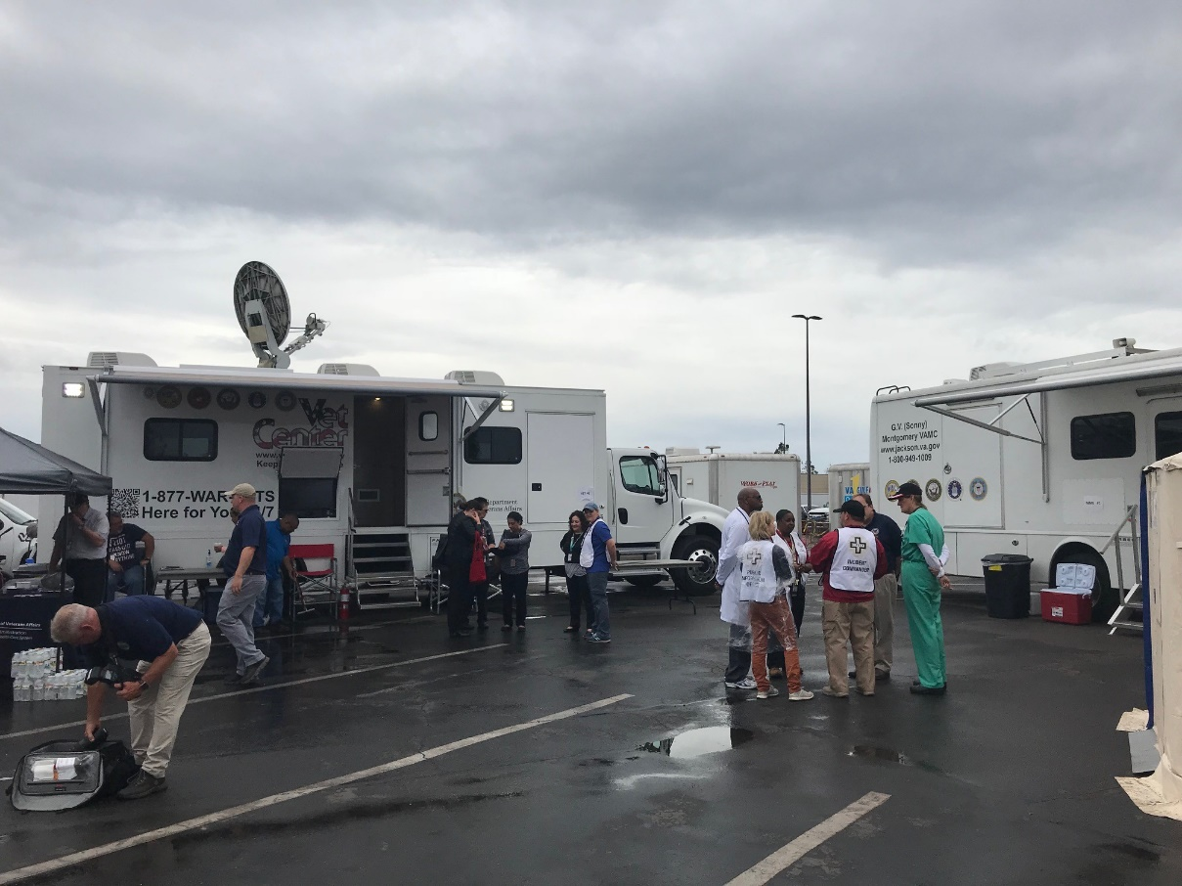
Disaster Emergency Medical Personnel System (DEMPS)
DEMPS is the VHA program for deployment of clinical and non-clinical staff to an emergency or disaster.

Slide 7
Medical Center Volunteer Teams
Hospital Emergency Response Team (HERT)
The Martinsburg, WV VAMC HERT is a volunteer contingency response capability supporting all MVAMC. The HERT is comprised of staff from a variety of backgrounds and is open to clinical and non-clinical employees who meet membership criteria

Slide 8
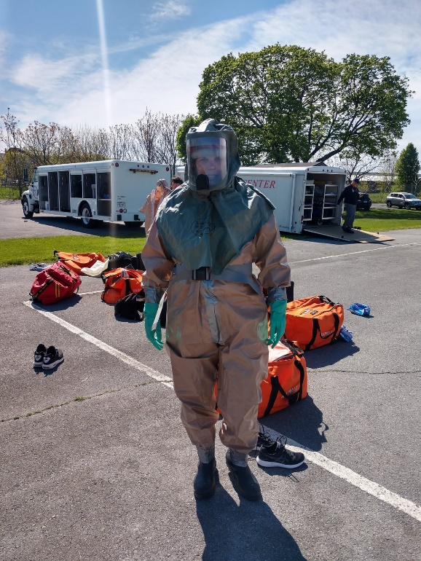
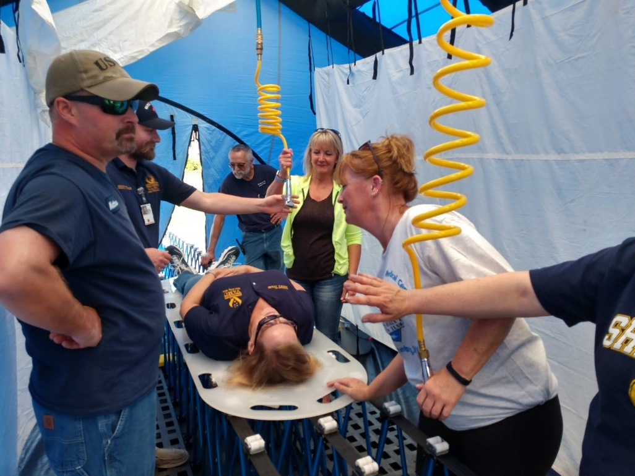
HERT
Decontamination Team

Slide 9
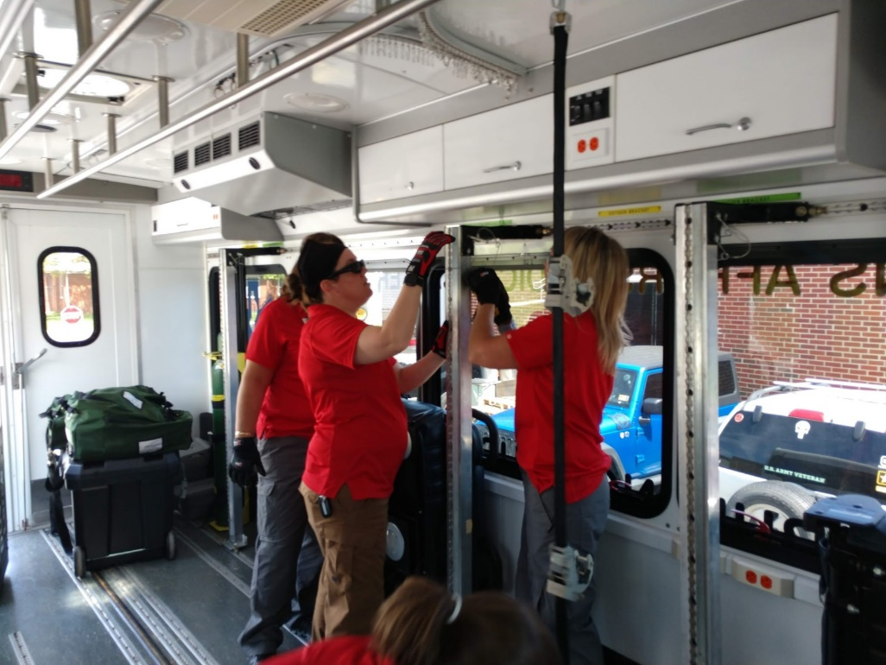
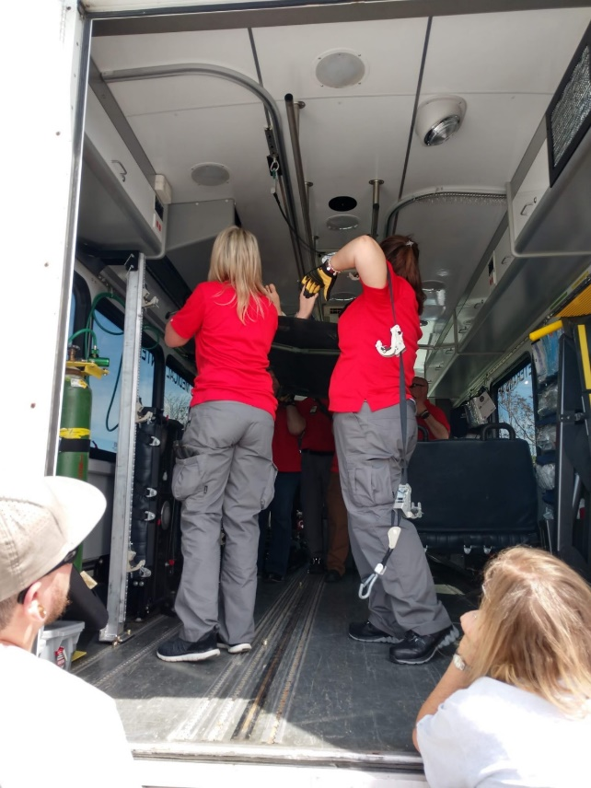
HERT
Dual Use Vehicle Team (DUV)

Slide 10
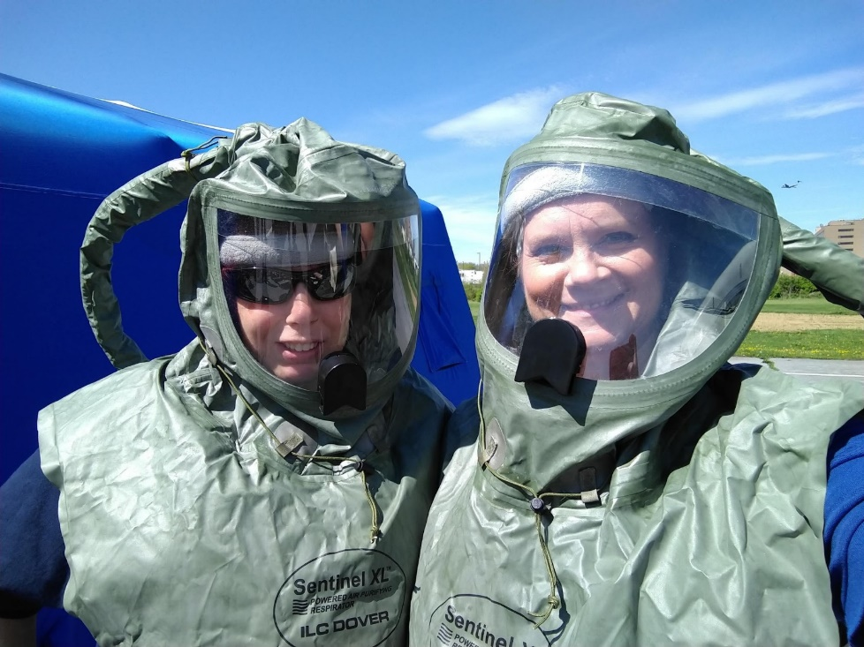
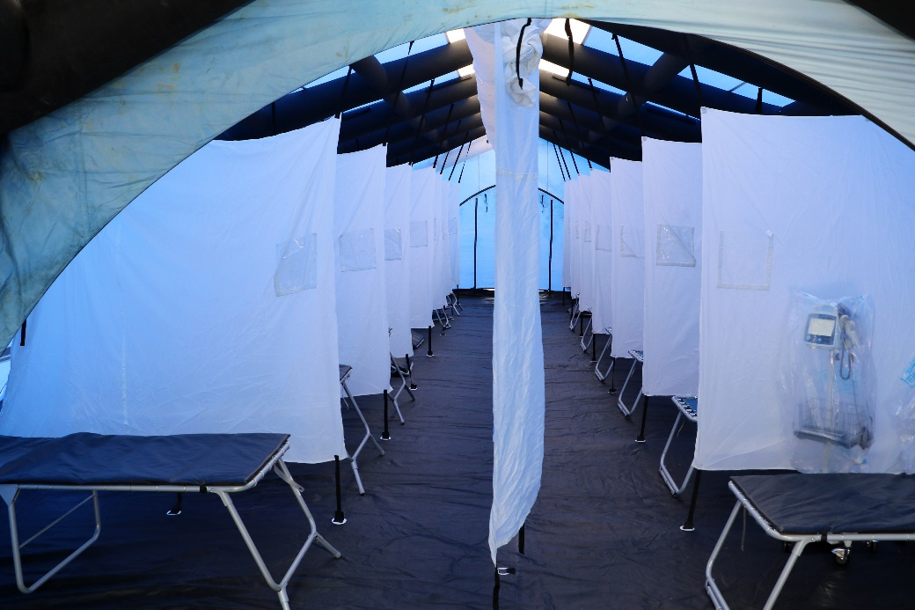
HERT
Infectious Disease Response Team (IDRT)

Slide 11
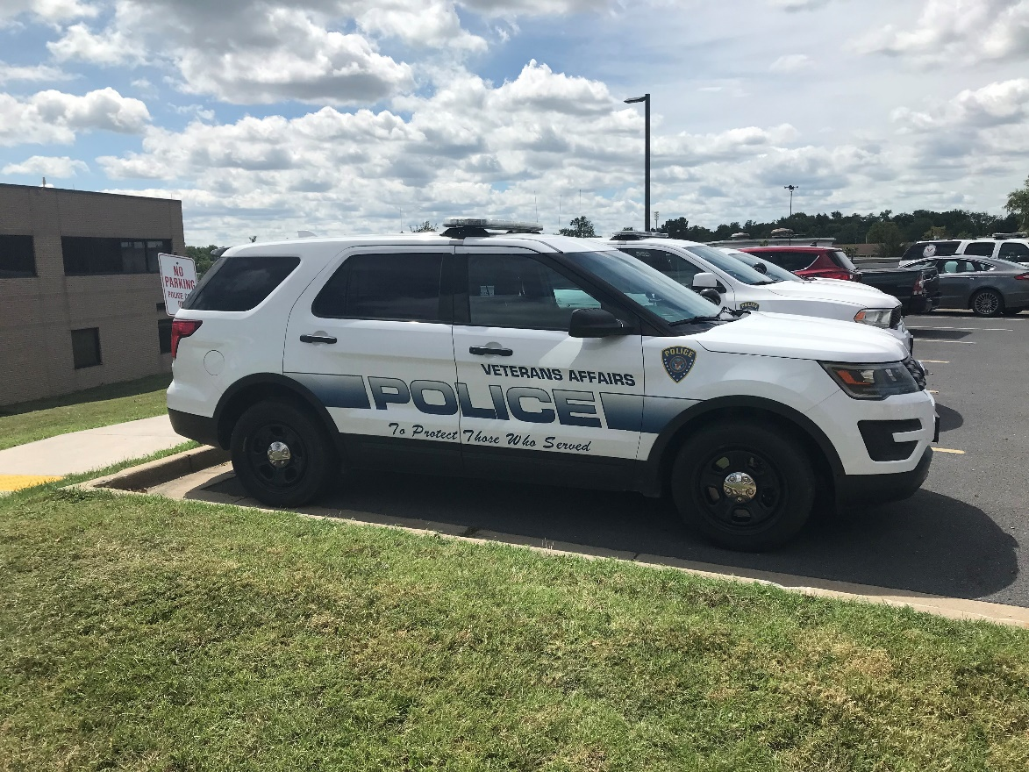
HERT
Police Augmentee

Slide 12
Other Support Available
Zumro & Texas Shelters
Isolation Pod
Mobile Morgue

Slide 13
Questions
For more information on the Martinsburg VAMC Emergency Management office:
(304) 263-0811 ext. 1234 or
MWV-EmergencyManagement@va.gov

